Slide 2
Welcome
This presentation and more at
https://github.com/MSFTAuDX/HackForGood

Slide 3
This session is being live-streamed
http://aka.ms/H4GStream

Slide 4
Agenda
Introduction
Hack Logistics, T&Cs
Ideas
Q&A

Slide 5
Introduction
Andrew Coates
Microsoft

Slide 6
Logistics
Megan Mallin
Microsoft

Slide 7
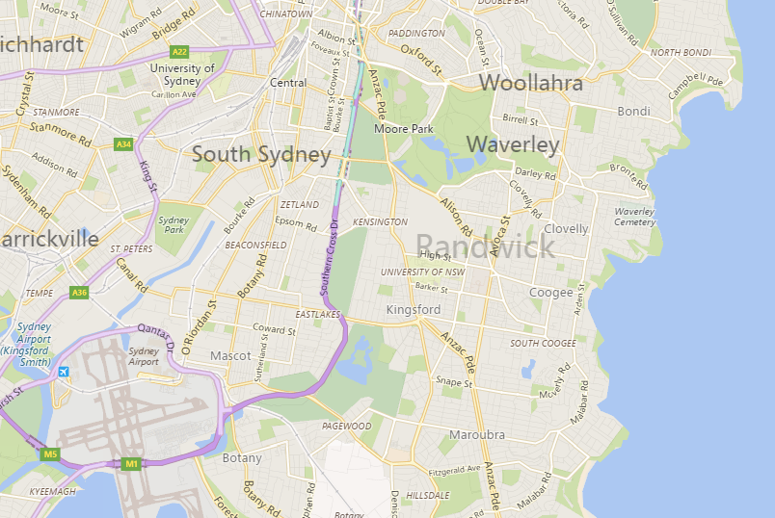
Hack Location
UNSW

Slide 8
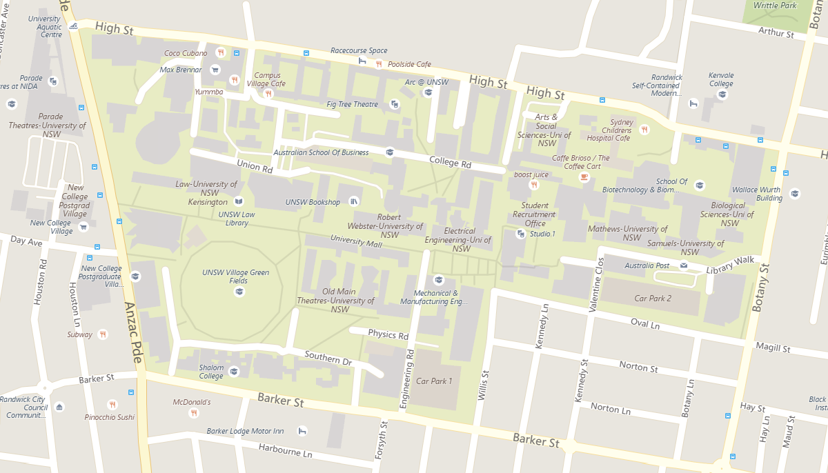
Hack Location
Colombo

Slide 9
Hack for Good Schedule
Monday 16 November
10:00 | Opening/Welcome
10:30 | Hack Begins
12:30 | Lunch
18:00 | Dinner
22:00 | Close
Tuesday 15 November
08:00 | Open
12:30 | Lunch
16:00 | Judging Begins
17:30 | Canapés and Judges Deliberate
18:00 | Final 3 announced
19:00 | Close

Slide 10
Register for the Hackathon
https://aka.ms/hackregistration

Slide 11
Developer Event
Wednesday 16 November
All hackers VIP seating
Finalists meet Satya Nadella before keynote
Winner announced during keynote

Slide 12
Developer Event Schedule
Wednesday 16 November
09:00 | Finalists Meet Satya Nadella (actual time TBC)
10:00 | Developer Event Begins
12:45 | Developer event concludes

Slide 13
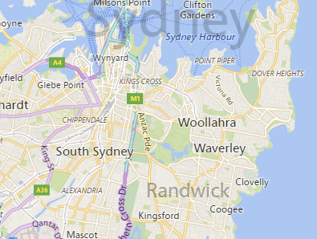
Developer Event Location
Star
UNSW

Slide 14
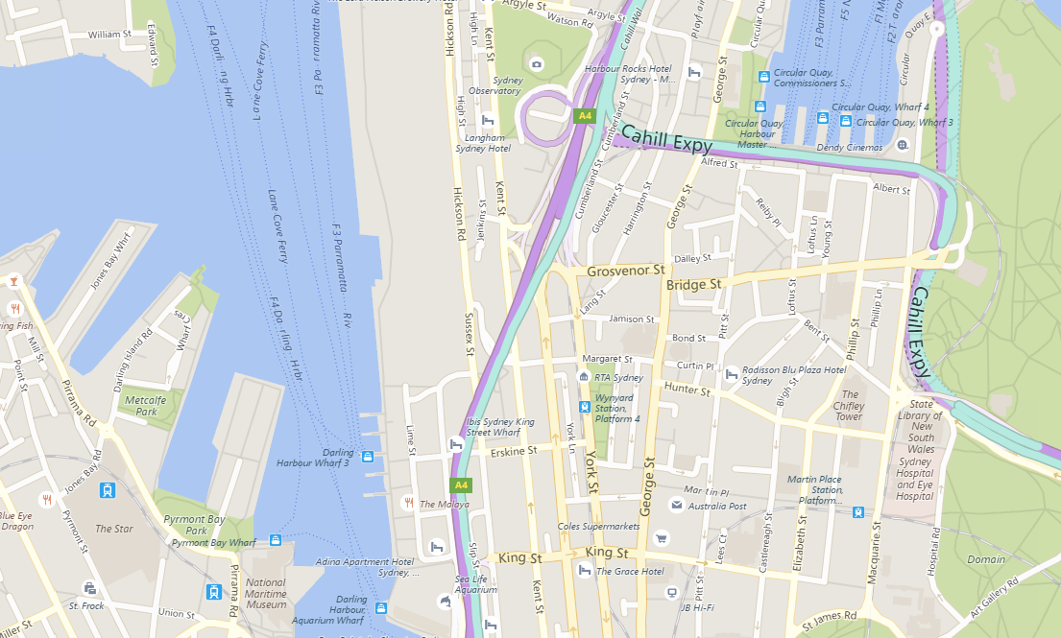
Developer Event Location
Star

Slide 15
Register for the Developer Event
https://aka.ms/sydneydev

Slide 16
Terms and Conditions
David Masters
Microsoft

Slide 17
T&Cs
Judges
Judging Criteria
Prizes
Code of Conduct

Slide 18
Judges
Suzanne Colbert
Australian Network for Disability
TBC
Social Ventures Australia
Wayne Hawkins
ACAN
Marie Johnson
National Disability Insurance Agency
Lawrence Crumpton
Microsoft Australia

Slide 19
Judging Criteria
CATEGORY | JUDGING CRITERIA | Wt
Impact & Innovation | Does the project address a genuine problems faced by people living with a disability Is the problem addressed in new or improved way rather than duplicating existing technologies or efforts Does the project clearly and meaningfully innovate beyond those existing products or services? Does the project present a new and meaningful improved way of accomplishing something? Does the project include innovations in user experience? | 50%
Feasibility & Collaboration | Does the team have a credible plan for getting their project to market in terms of any required partnerships, or other factors? Does the team demonstrate external validation for their project such as customer research, input from relevant industry organisations or support services Solution has sustainable life-cycle and it is already working, utilizes a well-established open source community supported framework and has multi-platform support | 25%
Execution | Is the solution easy to use? Is it intuitive, flow of solution makes sense, clear, easy to use at first glance, professional/fun Does the project have a professional degree of production in terms of user interface, visuals, and audio? Does the project perform well and respond crisply to input? Does the project make effective and appropriate use of the major features of its chosen platform(s)? Were there significant platform features or platforms the project could have benefited from but failed to utilise? | 25%

Slide 20
Prizes – Top 2 teams
Opportunity to meet with Microsoft CEO Satya Nadella on 16th November in Sydney
Dedicated ongoing support through Social Ventures Australia – this includes mentoring, ideation, project implementation and more (Valued at up $30K per team)
Invitation to attend Microsoft premier technical training event – Ignite Australia (14-17 Feb 2017, Gold Coast) with access 150+ technical training sessions, access to 150 Microsoft staff and networking opportunity (Ticket Value $2,200 per person)
Opportunity to showcase your project at Microsoft Ignite Australia to 2,500 of Australia’s top Developer and IT Professionals from across Australia
Your project featured in Microsoft promotional activities both locally and internationally

Slide 21
Prizes
2 Categories
Public/Community
Private
Social Ventures Australia
Services/Funding
Ignite Tickets + Session (up to 5 per team)

Slide 22
Ideas
Amy Whalley
Australian Network for Disability

Slide 23
Accessible Development Resources
David Masters
Microsoft

Slide 24

Microsoft Accessibility site
Explore our work
Your source for guides, demos and tutorials
http://www.microsoft.com/accessibility
Notes:
Suggested Prompt 1: As part of our commitment to be transparent, accountable, and inclusive with regards to accessibility, Microsoft has launched an accessibility web portal at www.microsoft.com/accessibility. You can explore the work we are doing to foster an inclusive culture, use inclusive design, develop accessible products, and offer customer support for accessibility issues.
Suggested Prompt 2: You may already be familiar with the Microsoft Enable site as a source for guides, demos, and tutorials. You can access all of that material from the new accessibility website where we are transitioning from the original site and adding even more resources.

Slide 25
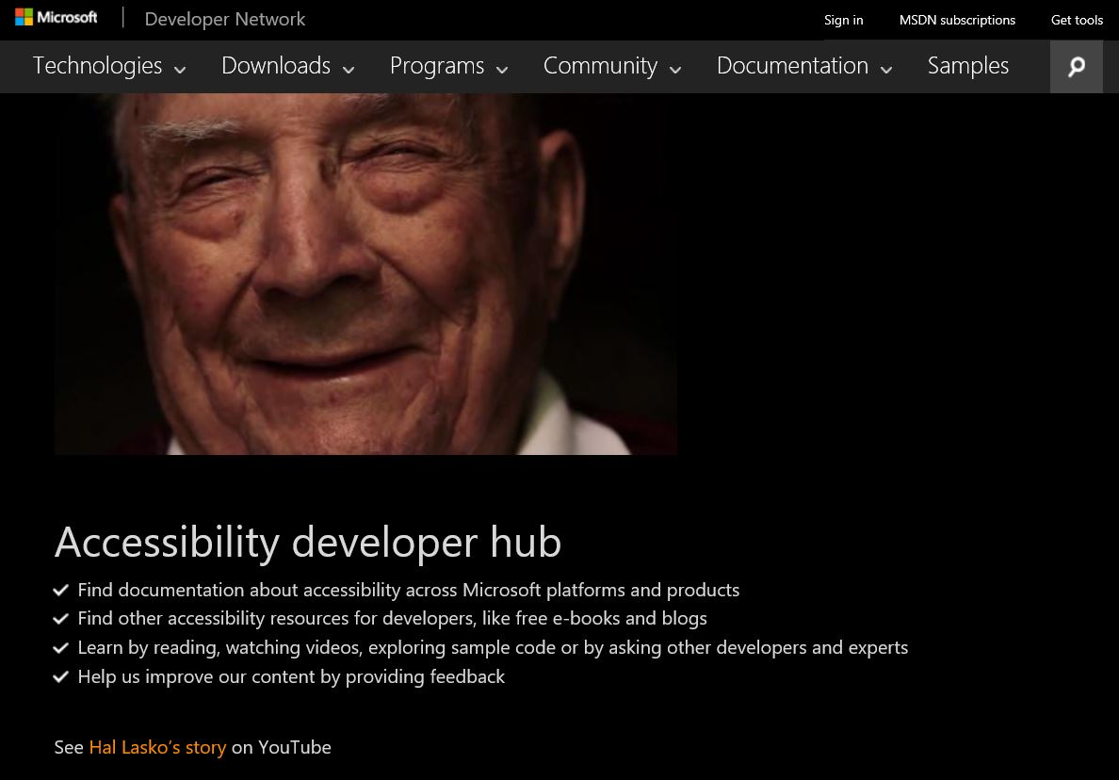
Accessibility developer resources
Sample code
Documentation
Free e-book on engineering accessible software
https://developer.microsoft.com/en-us/windows/accessible-apps
Notes:
Suggested Prompt 1: Another great resource is the Accessibility Developer Hub. This is a site where you can find accessibility resources for developers, like free eBooks and blogs, as well as documentation about accessibility across Microsoft platforms and products. There are opportunities to learn by reading, watching videos, exploring sample code, or by asking other developers and experts. You can also help us improve our content by providing feedback.

Slide 26
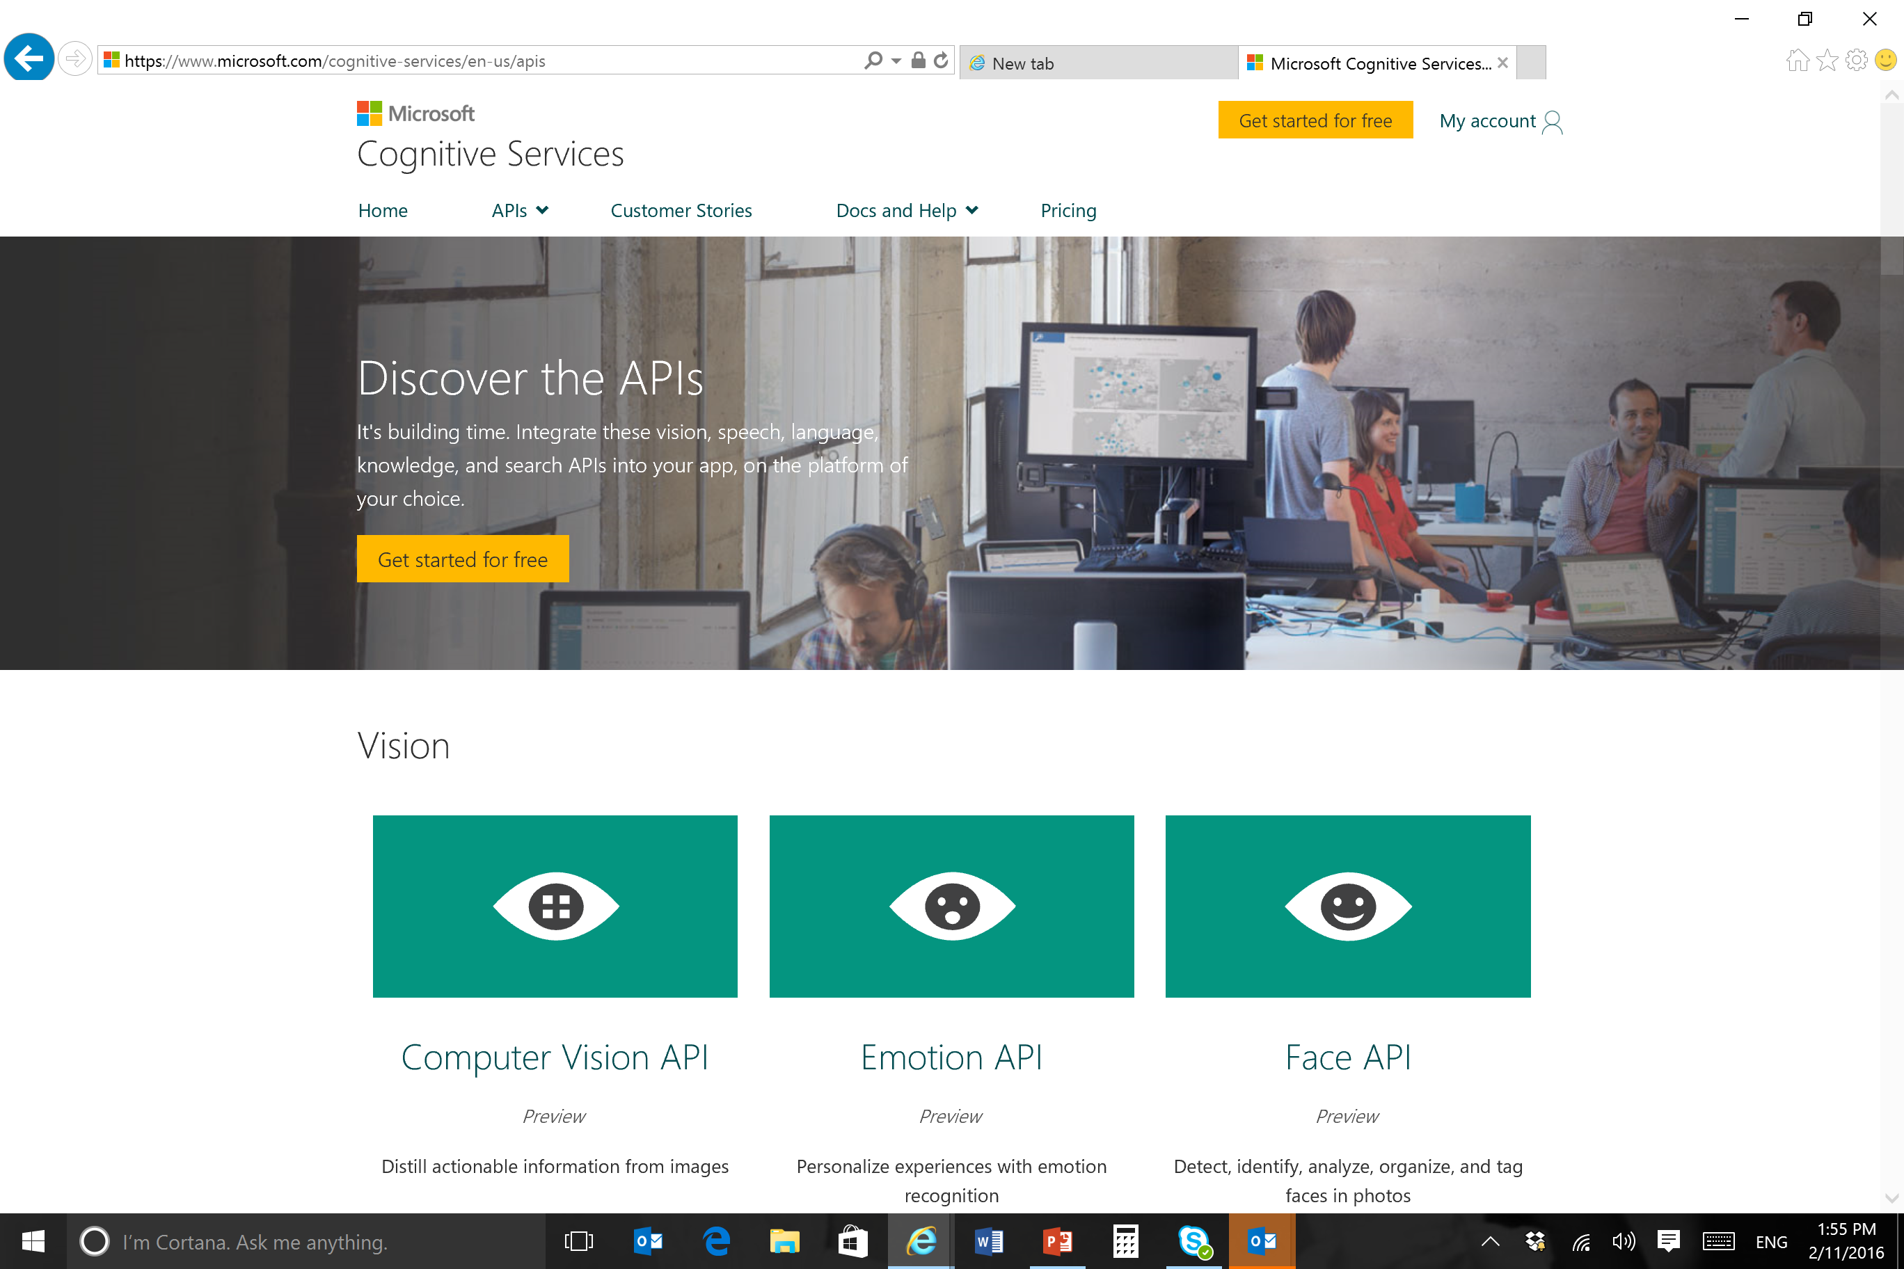
Cognitive Services APIs
APIs for Vision, Natural language queries, Translation, Speech recognition, Text-to-speech etc
https://www.microsoft.com/cognitive-services/en-us/apis

Slide 27
Inclusive Design
http://www.microsoft.com/design

Slide 28
Q&A

Slide 29
All this and more
https://github.com/MSFTAuDX/HackForGood
https://aka.ms/hackregistration
https://aka.ms/sydneydev

